Slide 1
Comparison of Dynamic Web Content Processing Language Performance
Under a LAMP Architecture
Musa Jafar
Russell Anderson
Amjad Abdullat
Information & Decision Management Dept
West Texas A&M University
mjafar@mail.wtamu.edu
randerson@mail.wtamu.edu
aabdullat@mail.wtamu.edu

Slide 2
Presentation Outline
LAMP
Appliance Framework
Test Scenarios
Test Results
Summary and observations

Slide 3
Web Interaction Scenario Scenario

Slide 4
What is LAMP
LAMP is an open source, web-based application solution stack. It is comprised of
  (1) an operating system platform running Linux,
  (2) an Apache web server,
  (3) a MySQL database management system, and
  (4) a Dynamic Web Content Processor language such as Perl, Python or PHP scripting languages paired with its corresponding MySQL Database Interface Module.

Slide 5
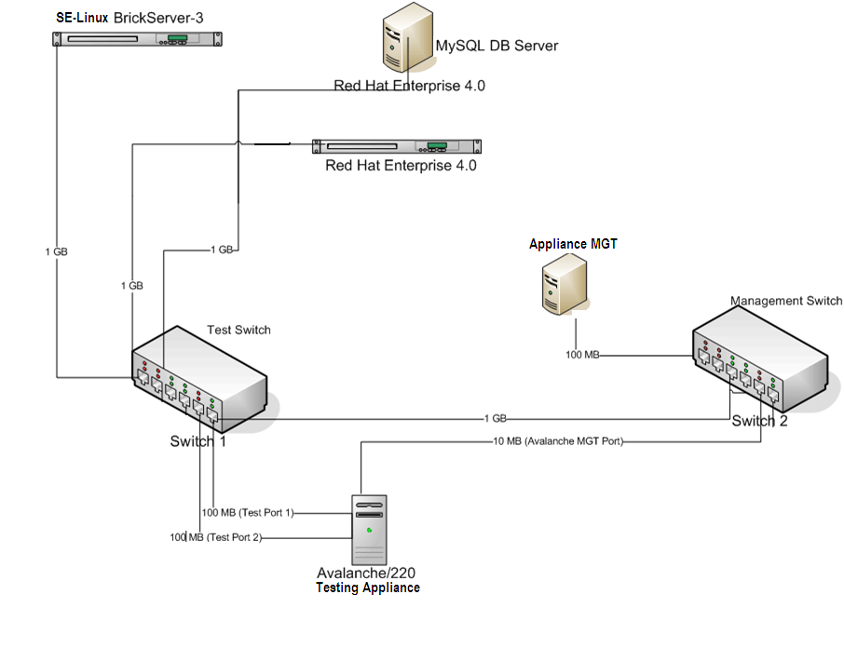

Slide 6
Concurrent Users Test Configurations
scenario One (Pure CGI, No database Connectivity)
scenario Two (a Simple Database query)
Scenario Three (a Database Insert-Update-Delete Transaction)

Slide 7
Test Configuration
For each platform (SE Linux, Redhat)
For each language (Perl, Python, PHP),
For each number of concurrent users (1,5,10,25,50,75,100,125,50)
configure a test,
perform and monitor a test
gather test results
End For
End For
Tabulate, analyze and plot the average-page-response time for Perl, Python and PHP under a platform
End For

Slide 8
Pure CGI Scenario

Slide 9
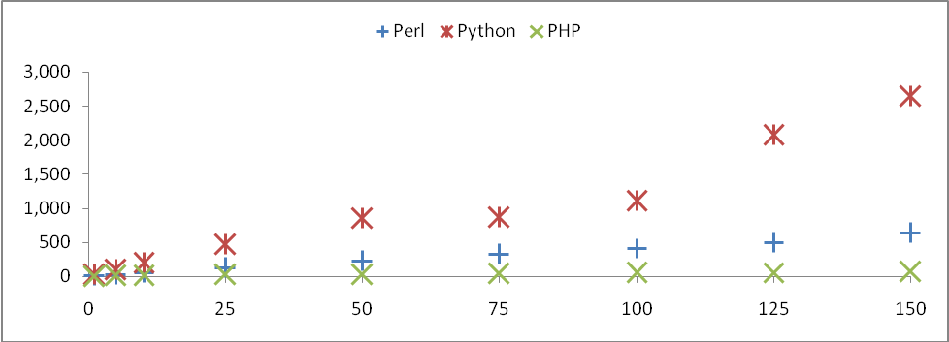
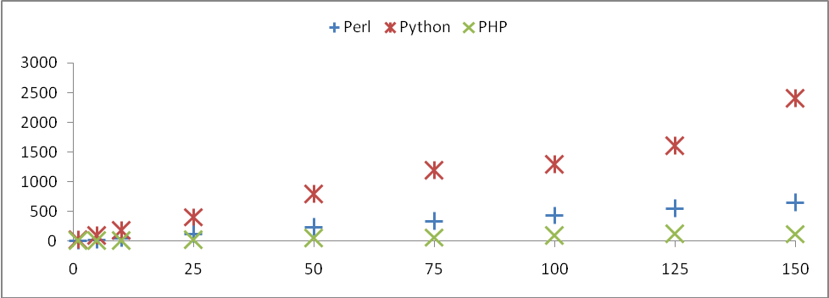
Figure 4: SE Linux, Dynamic Web Page Request
Figure 5: Redhat Dynamic Web Page Request

Slide 10
DBI Scenario

Slide 11
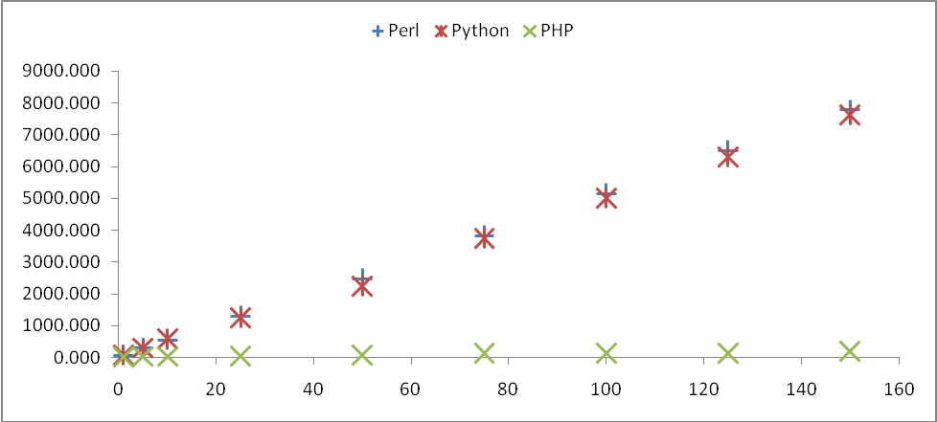
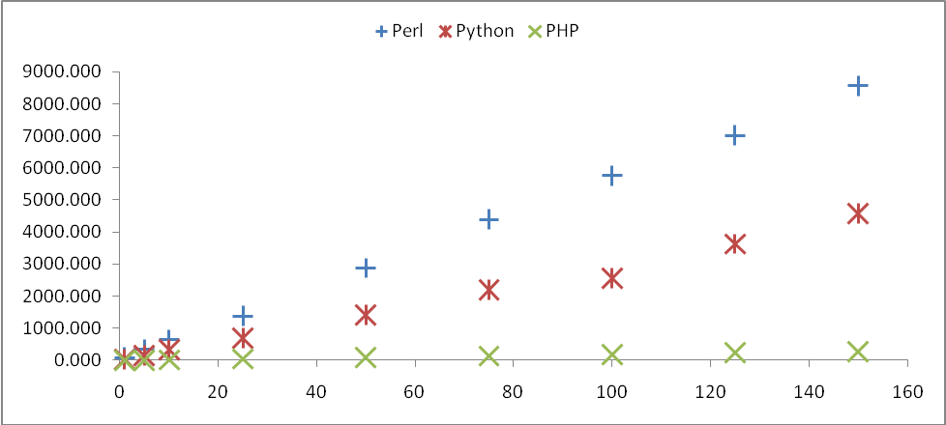
Figure 6: SE Linux, Simple Query Request
Figure 7: Redhat Simple Query Request

Slide 12
DBI Scenario

Slide 13
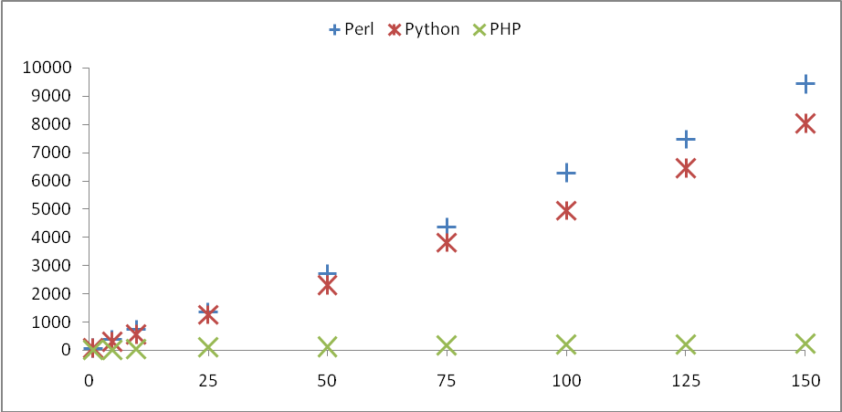
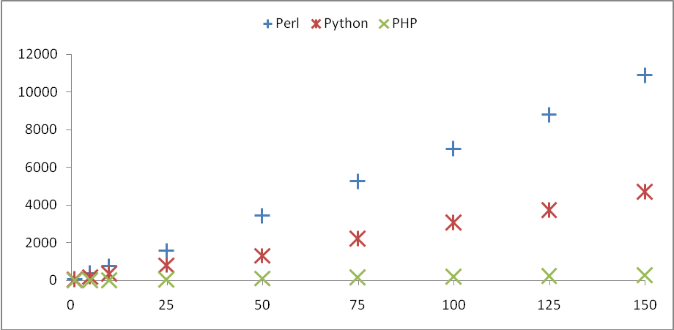
Figure 8: SE Linux, Insert, Update, Delete Transaction
Figure 9: Redhat Insert, Update, Delete Transaction

Slide 14
Summary and Observations
Multi-tiered, HTTP based applications suffer from the inability of the HTTP protocol to propagate meaningful error and status information from a back-end tier, such as the data tier, to the presentation tier – the web client.
Web clients communicate with a web server only.
Standards for communicating server status information to the client were defined as static status-codes ranging from 1XX to 5XX by W3C protocol including the classic “404 Not Found” status-code (RFC-2616, 1999, HTTP 1.1). These values are numeric and hard coded.
Status Codes are not extensible to allow for the encoding of status information from a back-end tier such as a database server.

Slide 15
Summary and Observations
An appliance framework allows performance engineers to focus on the task at hand. Tests can be replicated, reconfigured and reproduced in a matter of minutes through the graphical user interface of the appliance.
The appliance framework transforms the job of the performance engineer from a programmer to that of a test designer and analyzer.
Automatic testing exposed the limitations of the HTTP protocol in propagating third-tier status codes such as database connection timeouts, deadlocks and violations as HTTP header information to the web-client for interpretation

Slide 16
Summary and Observations
Our Kludgy
Propagating remote tier errors to the client, reported as a special category of HTTP error code that is not within the range of our experiment codes.
#!/usr/bin/perl
use strict;
use DBI();
………
if(my $x = DBI::err) {
my $y = DBI::errstr;
responseBack(501, "$x $y DBI Error");
}
sub responseBack {
my $err = 501;
my $message =
"Connection to Database Failed";
my $results = "$err $message";
if(@_){
($err, $message, $results) = @_;
}
print("status: $err $message\n");
print("content-type: text/html\n\n");
print("<html>\n");
……………………….
print("</html>\n");
exit;
}

Slide 17
Questions?
Thank You

