Slide 1

THE START
Array Research:
A Research
Example
Pace University
325 Goldstein AC PVL
&
416A WP GC
rfrank @ pace.edu
Notes:
Header slide.

Slide 2
Table of Contents 1/3
☺ TOC 69 (27 Head, 42 text) 3[2-4]
☺ Research “Tree” Flow Diagram 3[5-7]
☺ Observation & Binomial Theorem 3 [8-10]
☺ Scalars & 1-D Vectors 3 [11-13]
☺ Outer Products & 0-D Null Arrays 3 [14-16]
☺ Master Equation 3[17-19]
☺ Mystery Solved 3[20-22]
☺ Catenation (Try 1) 3[23-25]
24
Notes:
TOC 1 of 3

Slide 3
Table of Contents 2/3
☺ Analysis of Catenation 3 [25-27]
☺ The Law of Catenation 3 [28-30]
☺ Continuous Arrays 3 [31-33]
☺ Negative Length Arrays & Dual View 4[34-37]
☺ Complex (& Imaginary) Length 3 [38-40]
☺ Fractional Dimensions 3 [41-43]
☺ P(F(A))= F(P(A)) 4[44-47]
☺ Given P(A), Find A. (Roots) 3[48-50]
26
Notes:
TOC 2 of 3

Slide 4
Table of Contents 3/3
☺ Structure Topology Questions 3 [51-53]
☺ Catenation and the Big Bang 3[54-56]
Alternative
☺ Summary 2[57-58]
☺ Appendix I: The Binomial Theorem 2[59-60]
☺ Appendix II: The Binomial Coefficients 3[61-63]
☺ Appendix III: Some Coefficients of (1+X)^{1/2} 2[64-65]
☺ Appendix IV: Detail of “Big Bang” 4[66-69]
19
Notes:
TOC 3 of 3

Slide 5
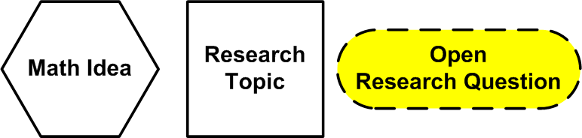
The “Tree” Flow of the Research
Notes:
Title: The “Tree” Flow of the Research

Slide 6
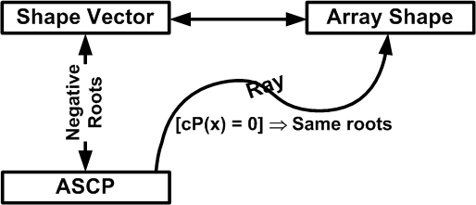
Discovered
“Array Structure Characteristic Polynomial”
Polynomial == “Polynomial Form”
Notes:
Relationships: An array’s shape vector to its Array structure characteristic “polynomial” to its geometrical shape.
The polynomial is a polynomial FORM that follows polynomial algebra.

Slide 7
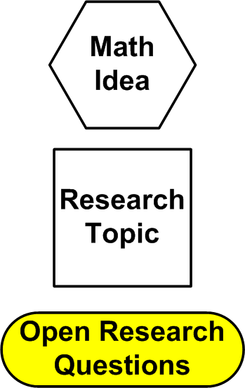
Notes:
The detail “tree” [graph] of my research.

Slide 8
The Observation, & Binomial Theorem
Notes:
Title: The Observation, & Binomial Theorem

Slide 9
Notes:
The detail “tree” [graph] of my research – Title: The Observation, & Binomial Theorem

Slide 10
Basic Representation Idea
Basic Binomial Theorem Idea
Notes:
Observation, T^{N} in terms of length one less (implies hierarchical structure), All scalars the same.

Slide 11
All Dimension Scalars Are =
&
The Canonical 1-D 1-Vector Array
Notes:
Title: All Dimension Scalars Are = , & The Canonical 1-D 1-Vector Array

Slide 12
Notes:
The detail “tree” [graph] of my research – All Dimension Scalars Are = , & The Canonical 1-D 1-Vector Array

Slide 13
Derivation of
RECURSION
Derivation of a 1-D, N-vector polynomial form
RECURSION
Notes:
The recursive derivation of the 0-D null array and the 1-D null Array.

Slide 14
Outer Product , Null Arrays, {2, 3} Example
Arrays are Made by Outer Product of 1-D k-Vectors
(The k_{i} are the elements of the shape vector)
The Algebra of Null Arrays
&
A {2, 3} Array Structure Example
Notes:
Title: Arrays are Made by Outer Product of 1-D k-Vectors & The Algebra of Null Arrays & A {2, 3} Array Structure Example
The Algebra of Null Arrays
&
A {2, 3} Array Structure Example

Slide 15
Notes:
The detail “tree” [graph] of my research : Arrays are Made by Outer Product of 1-D k-Vectors

Slide 16
CREATING A {2, 3} ARRAY BY THE OUTER PRODUCT OF VECTORS
Polynomial
Multiplication
This means 6 Cells (0-D Scalars), 5 1-D Vectors, 1 (2-D) Thingie.
Notes:
Create Array {2,3} by outer product, & the null array shapes & their algebra using simple polynomial algebra.

Slide 17
The Master Equation
The Master Equation
Notes:
Title: Master equation

Slide 18
Notes:
The detail “tree” [graph] of my research – Title: Master equation

Slide 19
Sum over all combinations of N-j factors.
{2, 3, 4} Example
Notes:
master equation, & first try at catenation [coefs are symmetric fns, therefore transposition invariant poly] coefs sum over all combinations of N shape vector els, N-j at a time. 2x3x4 example.

Slide 20
Mystery Solved
Mystery Solved
Notes:
To array people, there was always a question:

Slide 21
{ }, {1}, {1, 1}, {1, 1, 1}
Contents Counts Are The Same
= 1
All Structure Polynomials Start With
The structure of an array is independent of the mapping to the co-domain that determines the cell contents.
Notes:
How come the dimension of an array did not affect the number of its cells?

Slide 22
First Try at Catenation
First Try at Catenation
Notes:
Naive catenation

Slide 23
Notes:
The detail “tree” [graph] of my research – Naive catenation on the way to the law.
.

Slide 24
Notes:
Naive catenation does not work.

Slide 25
Analysis of a Catenation Example
Analysis of a Catenation Example
Notes:
Title: Analysis of a Catenation Example

Slide 26
Notes:
The detail “tree” [graph] of my research - Analysis of a Catenation Example

Slide 27
The anti glue must be
subtracted from catenations
And
added (glued) into decatenations.
Notes:
Analysis of a Catenation Example: anti-glue must be subtracted.

Slide 28
The Law of Catenation
The Law of Catenation
Notes:
Title: The Law of Catenation

Slide 29
Notes:
The detail “tree” [graph] of my research – The Law of Catenation.

Slide 30
The anti glue must be
subtracted from catenations
And
added (glued) into decatenations.
Notes:
Real world egg crate example of catenation, & the law. This is also a property of our space.

Slide 31
Continuous Arrays
Continuous Arrays
Notes:
Title: Continuous Arrays.

Slide 32
Notes:
The detail “tree” [graph] of my research. - Continuous Arrays.

Slide 33
Notes:
Continuous arrays are just like discrete arrays.

Slide 34
Negative Length Arrays & the Dual View
Negative Length Arrays
Notes:
Title: Negative length arrays.

Slide 35
Notes:
The detail “tree” [graph] of my research - Negative length arrays. Dual view left out of this presentation.

Slide 36
Notes:
Negative length arrays

Slide 37
Notes:
Negative length array example & a positive example

Slide 38
Complex (or Imaginary) Length Array
Complex (or Imaginary) Length Arrays
Notes:
Title: Complex (or Imaginary) Length Arrays

Slide 39
Notes:
The detail “tree” [graph] of my research. Complex (or Imaginary) Length Arrays

Slide 40
Notes:
Complex (or Imaginary) Length Array catenation

Slide 41
Fractional Dimension Arrays
(The Square Root of a 1-Vector)
Fractional Dimension Arrays
(The Square Root of a 1-Vector)
[New results on shape vectors
adds to this]
Notes:
Title: Fractional Dimension Arrays & example (The Square Root of a 1-Vector) – only the polynomial form. Not the (different) shape vector form.

Slide 42
Notes:
The detail “tree” [graph] of my research Fractional Dimension Arrays & example (The Square Root of a 1-Vector)

Slide 43
Infinite dimensionality
Notes:
Fractional Dimension Arrays & example (The Square Root of a 1-Vector)

Slide 44
P(F(A)) = F(P(A)) Array Structure of Functions of Arrays
P(F(A)) = F(P(A))
Array Structure of
Functions of Arrays
[New results on shape vectors
adds to this]
Notes:
Title: P(F(A)) = F(P(A)) Array Structure of Functions of Arrays

Slide 45
Notes:
The detail “tree” [graph] of my research. P(F(A)) = F(P(A)) Array Structure of Functions of Arrays

Slide 46
Notes:
P(F(A)) = F(P(A)) Array Structure of Functions of Arrays (general formula for general fractional exponent) INVOLVES INFINITY OF DIMENSIONS.
Only the polynomial form shown. Not the (different) shape vector form.

Slide 47
Notes:
P(F(A)) = F(P(A)) SQUARE ROOT EXAMPLE OF GENERAL ARRAY. Two examples of squares of arrays.

Slide 48
Given P(A) Find A. Observation on “Defective” Arrays
Given P(A) Find A.
Observation on “Defective” Arrays
Notes:
Title: Given P(A) Find A. Observation on “Defective” Arrays.

Slide 49
Observation:
"Defective" arrays in ordinary space often have polynomials that lie in more complicated spaces.
Notes:
Given P(A) Find A (find roots). Observation on “Defective” Arrays

Slide 50
Notes:
Given P(A) Find A (find roots).

Slide 51
Questions About the Meaning of Array Representations –
The Topology of Array Structure
Questions About the Meaning of Array Representations –
The Topology of Array Structure
Notes:
Title: Questions About the Meaning of Array Representations – The Topology of Array Structure

Slide 52
Notes:
The detail “tree” [graph] of my research – Questions About the Meaning of Array Representations – The Topology of Array Structure

Slide 53
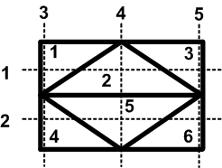
Same Array!!
Notes:
Two structure egg crate 2 picture examples of same structure. Mapping to a torus: array has same structure.

Slide 54
Catenation and the Big Bang (Alternative)
Catenation and the
Big Bang (Alternative)
Catenation applied to Steinhardt & Turok idea.
Notes:
Title: Catenation and the Big Bang (Alternative)

Slide 55
Notes:
Catenation of 2 4-D arrays, symbolically, their polynomials, and the excess array poly summary

Slide 56
Notes:
The excess in detail and its interpretation as a 3-D space at an instant.

Slide 57
Appendix: The Binomial Coefficients
SUMMARY
Notes:
Title: Appendix: Summary

Slide 58
Summary
☺ Example of following two ideas
☺ Discover new things
☺ Uncover unexpected connections
☺ Get new ideas on related connections
☺ Don’t limit your view to a “discipline”
☺ Keep notebooks
☺ Write something every day
☺ Use your unconscious
☺ Keep at it in spite of the “experts” (DeBroglie)
Notes:
Summary

Slide 59
Appendix: The Binomial Coefficients
Appendix I
The Binomial Theorem
Notes:
Title: Appendix: The Binomial Coefficients

Slide 60
Binomial Theorem
Notes:
Definition of the Binomial Theorem and some consequences.

Slide 61
Appendix: The Binomial Coefficients
Appendix II
The Binomial Coefficients
Notes:
Title: Appendix: The Binomial Coefficients

Slide 62
Notes:
Different views of the coefficients.

Slide 63
Notes:
Different views of the coefficients.

Slide 64
Appendix: The Binomial Coefficients
Appendix III
Some coefficients of (1+X)^{1/2}
Notes:
Title: Appendix III: Some more on the Coefficients of the polynomial square root.

Slide 65
Notes:
Some coefficients of (1+X)^{1/2}

Slide 66
Appendix: The Binomial Coefficients
Appendix IV
Details of “Big Bang”
Notes:
Title: Appendix IV: Some more detail on the catenation idea and the alternate big bang.

Slide 67
Notes:
Catenation of 2 4-D arrays, symbolically, their polynomials, and the excess array poly

Slide 68
Notes:
Catenation of 2 4-D arrays, symbolically, their polynomials in more detail

Slide 69
Notes:
Catenation of 2 4-D arrays, symbolically, their polynomials, and the excess array poly – the final form

Slide 70
THE END
Array Research:
A Research
Example
Notes:
Title: THE END

